Slide 1

CIFAR10 from Scratch

Slide 2
Reference
tf.keras.datasets
Youtube
Code

Slide 3


Slide 4
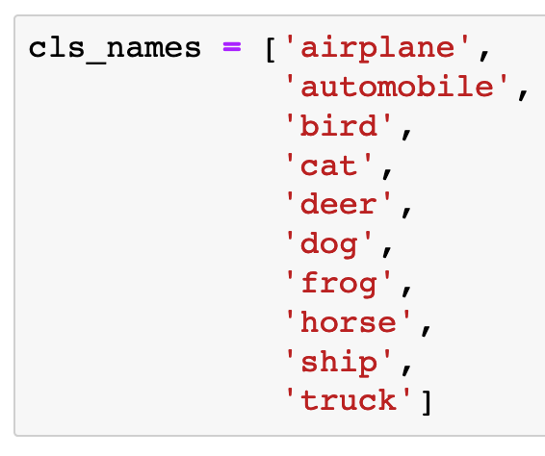

Slide 5
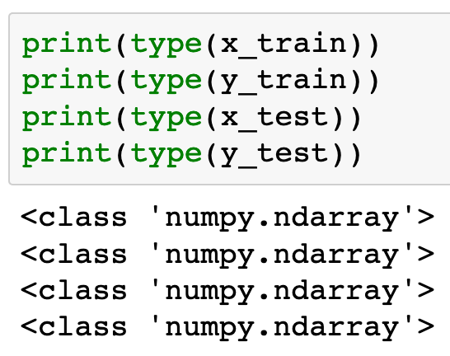

Slide 6
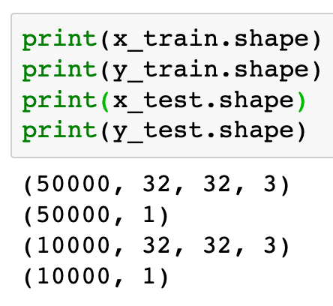

Slide 7
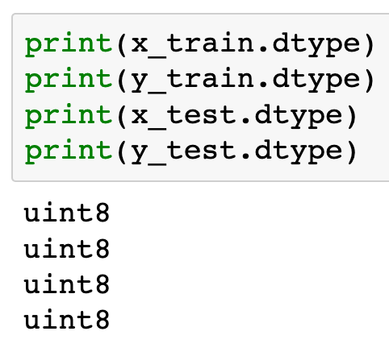

Slide 8
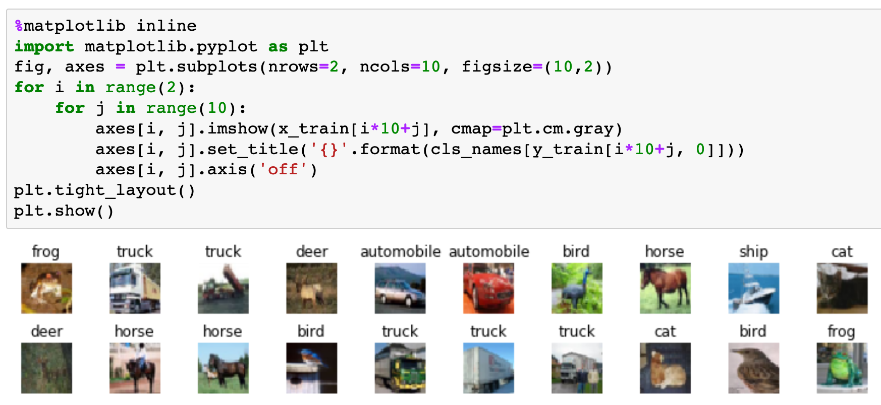

Slide 9
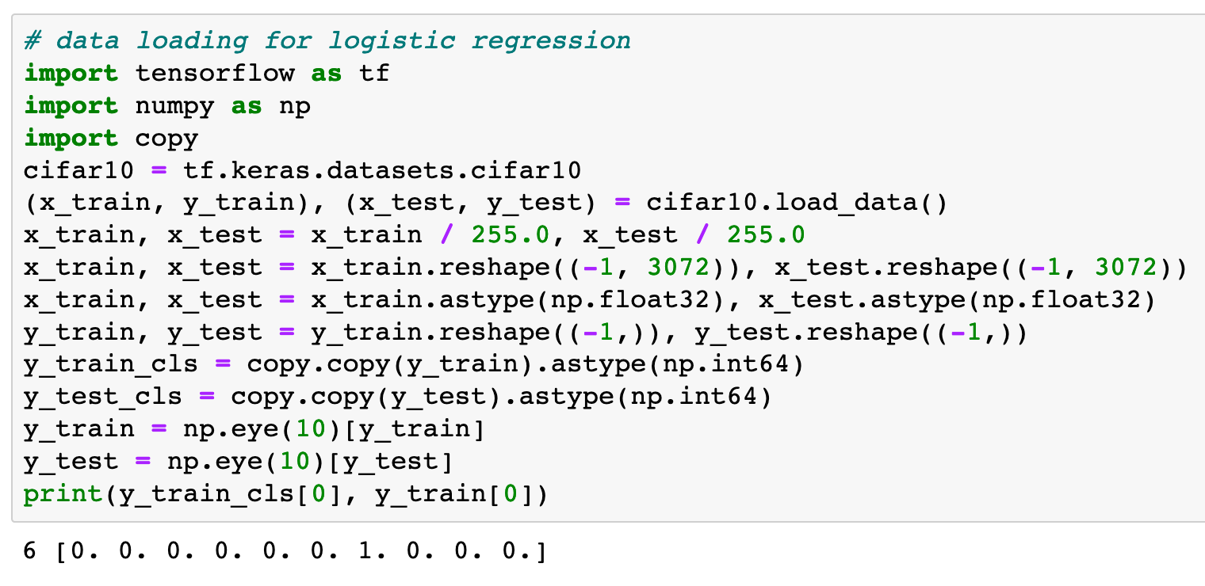

Slide 10
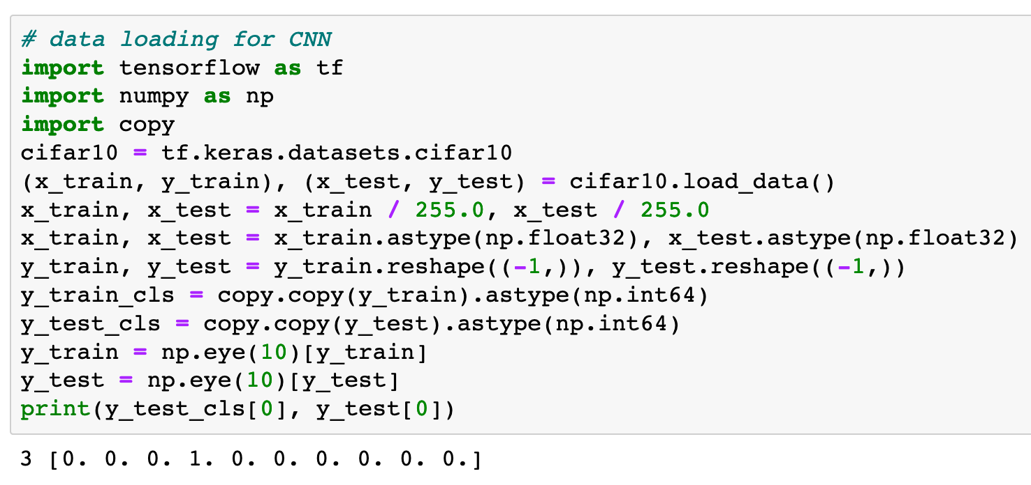

Slide 11
Now
Let’s Play with Code

